Slide 1
EDA for credit risk analysis
Presented by
Himanshu Rathod

Slide 2
Purpose
Credit risk analysis will help the company to make a decision for loan approval based on the applicant’s profile . which controls loss of business to the company and avoid financial loss for the company.

Slide 3
Steps involved in the EDA:
Data Loading and understanding.
Dealing with missing values,outliers and duplicate values.Data Cleaning and Data Preprocessing by using imputation and dropping methods.
Checking the data imbalance and Handling outliers using graphs and analysis.
Merging of application data with previous application data.
Univariate, Bivariate and Multivariate Analysis And Correlation.
Hot Encoding And Removing Multicolinearity.
Conclusions.

Slide 4
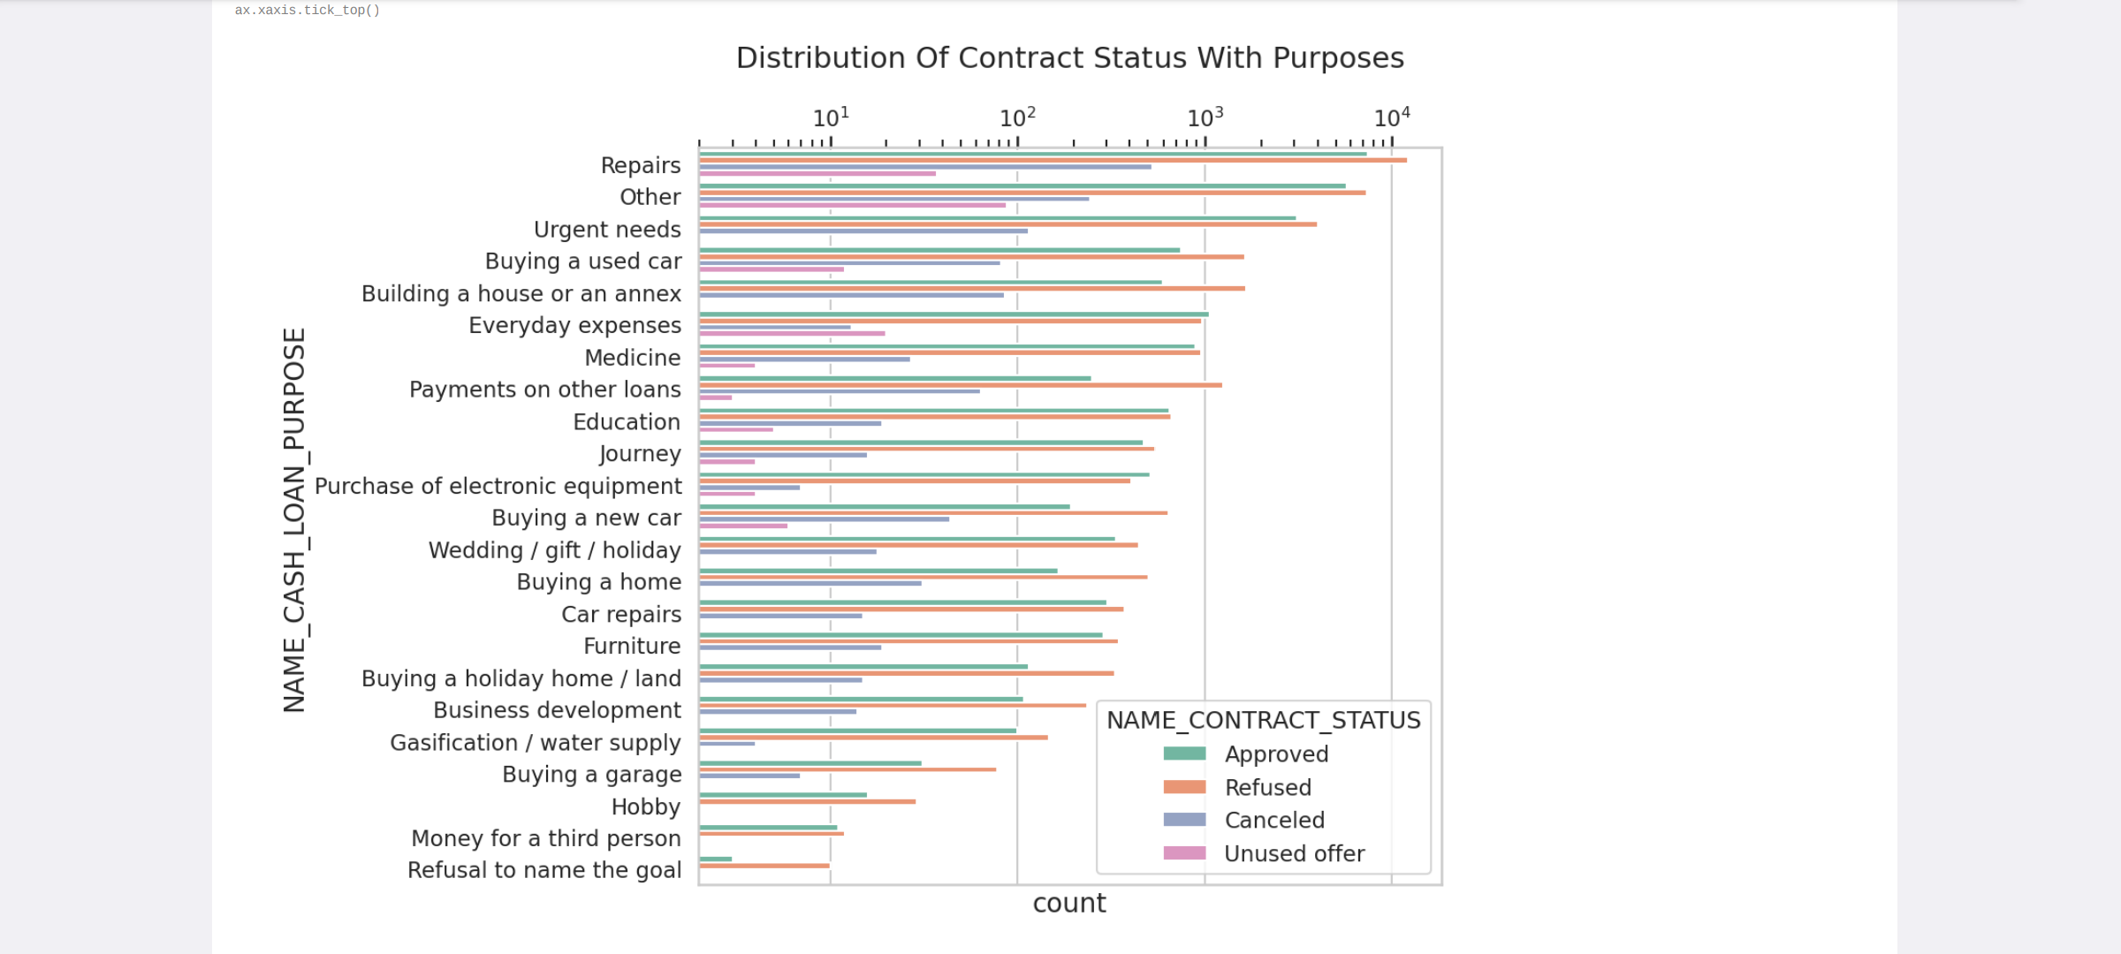
We can conclude the below points from the graph:
1.Most rejection of loans came from purpose 'Repairs'.
2.We have almost equal number of approves and rejection for Medicine,Every day expenses and education purposes.

Slide 5
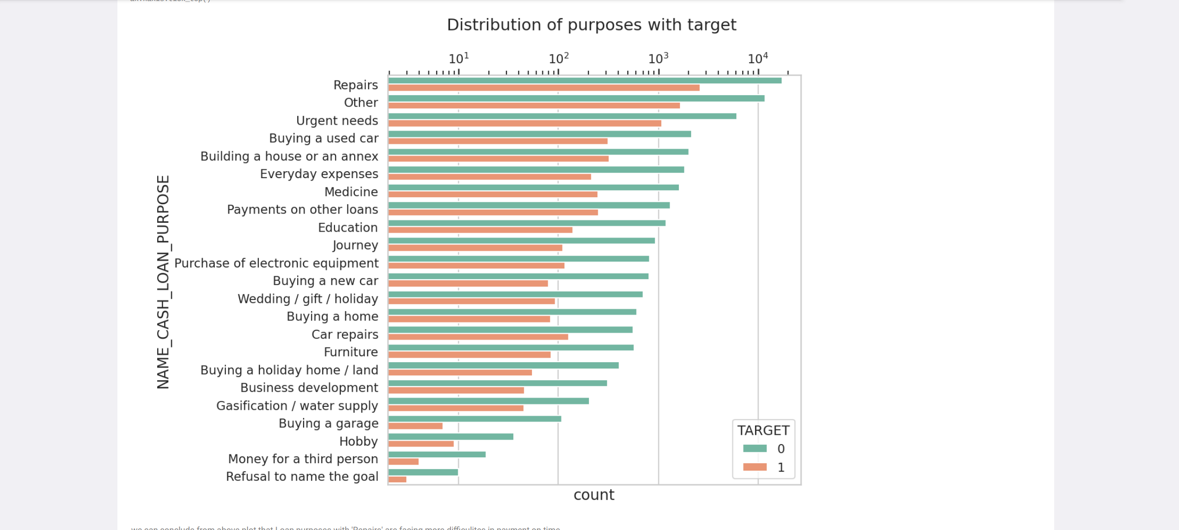
we can conclude from above plot that Loan purposes with 'Repairs' are facing more difficulties in payment on time.

Slide 6
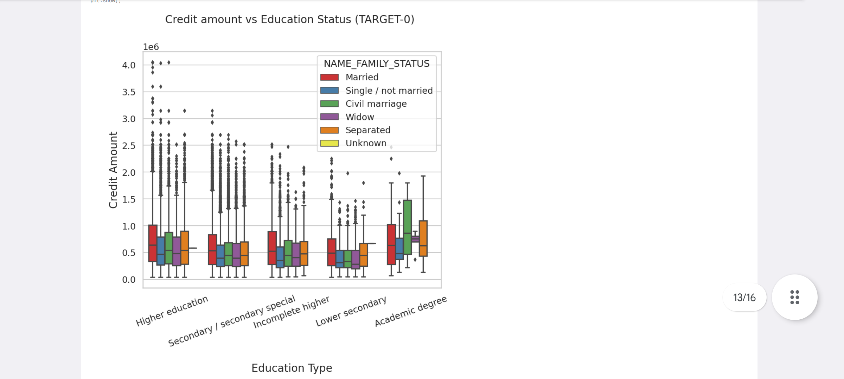
From the above box plot we can conclude that Family status of 'civil marriage', 'marriage' and 'separated' of Academic degree education are having higher number of credits than other. Also higher education of family status of 'marriage', 'single', and 'civil marriage' are having more outliers.

Slide 7
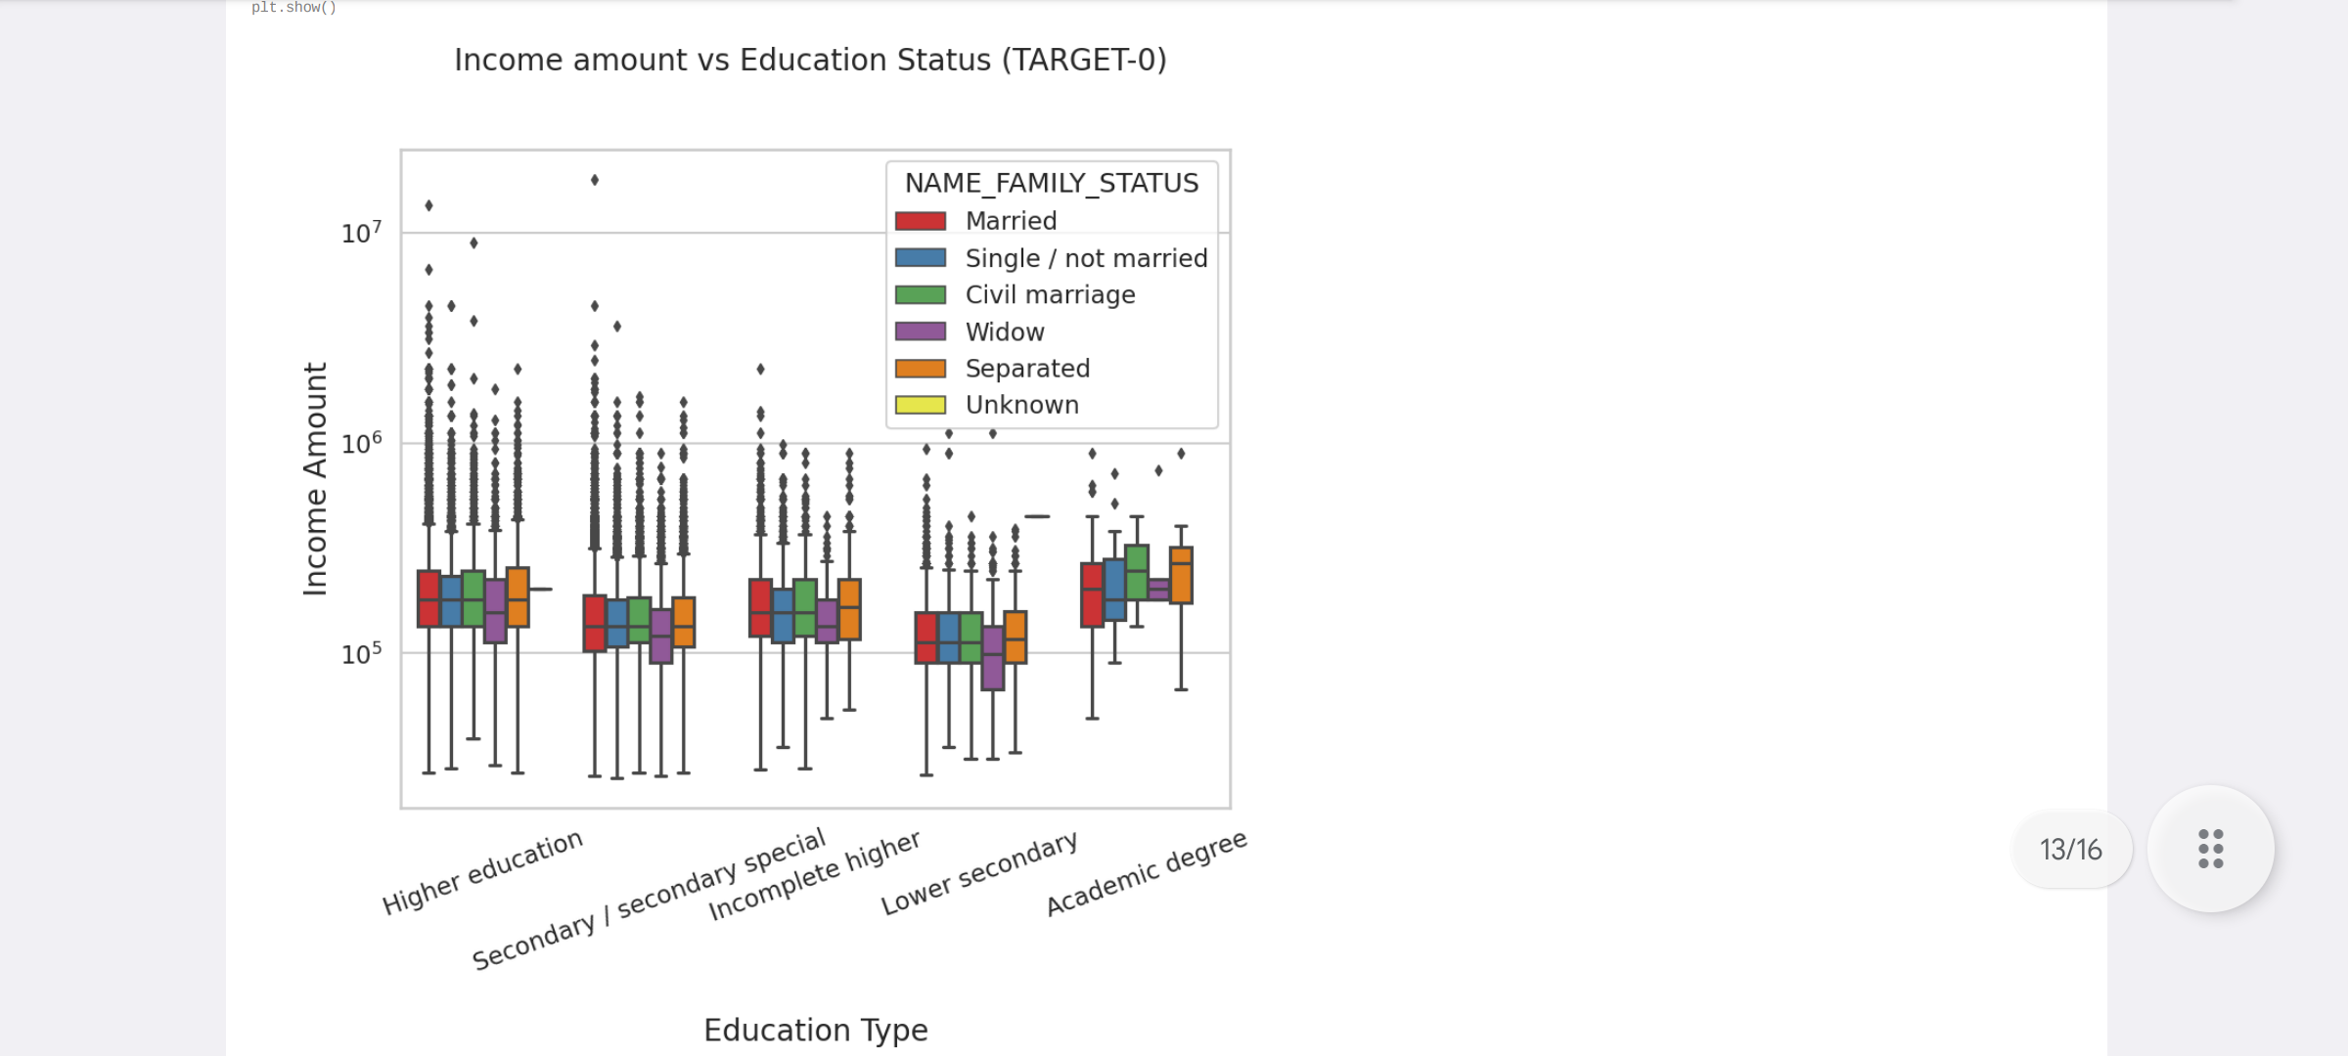
From the above boxplot for Education type 'Higher education' the income amount is mostly equal with family status. It does contain many outliers. Less outlier are having for Academic degree but there income amount is little higher that Higher education. Lower secondary of civil marriage family status are have less amount than outliers.

Slide 8
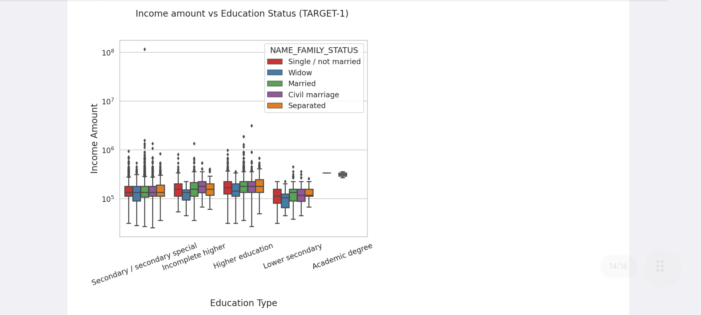
From the above analysis we can say that Family status of 'civil marriage', 'marriage', and 'saparated' of Academic degree education are having higher number of credits than others. Most of the outliers are from education type 'Higher education' and 'Secondary'. Civil marriage Academic degree is having most of the credits in the third quartile.

Slide 9
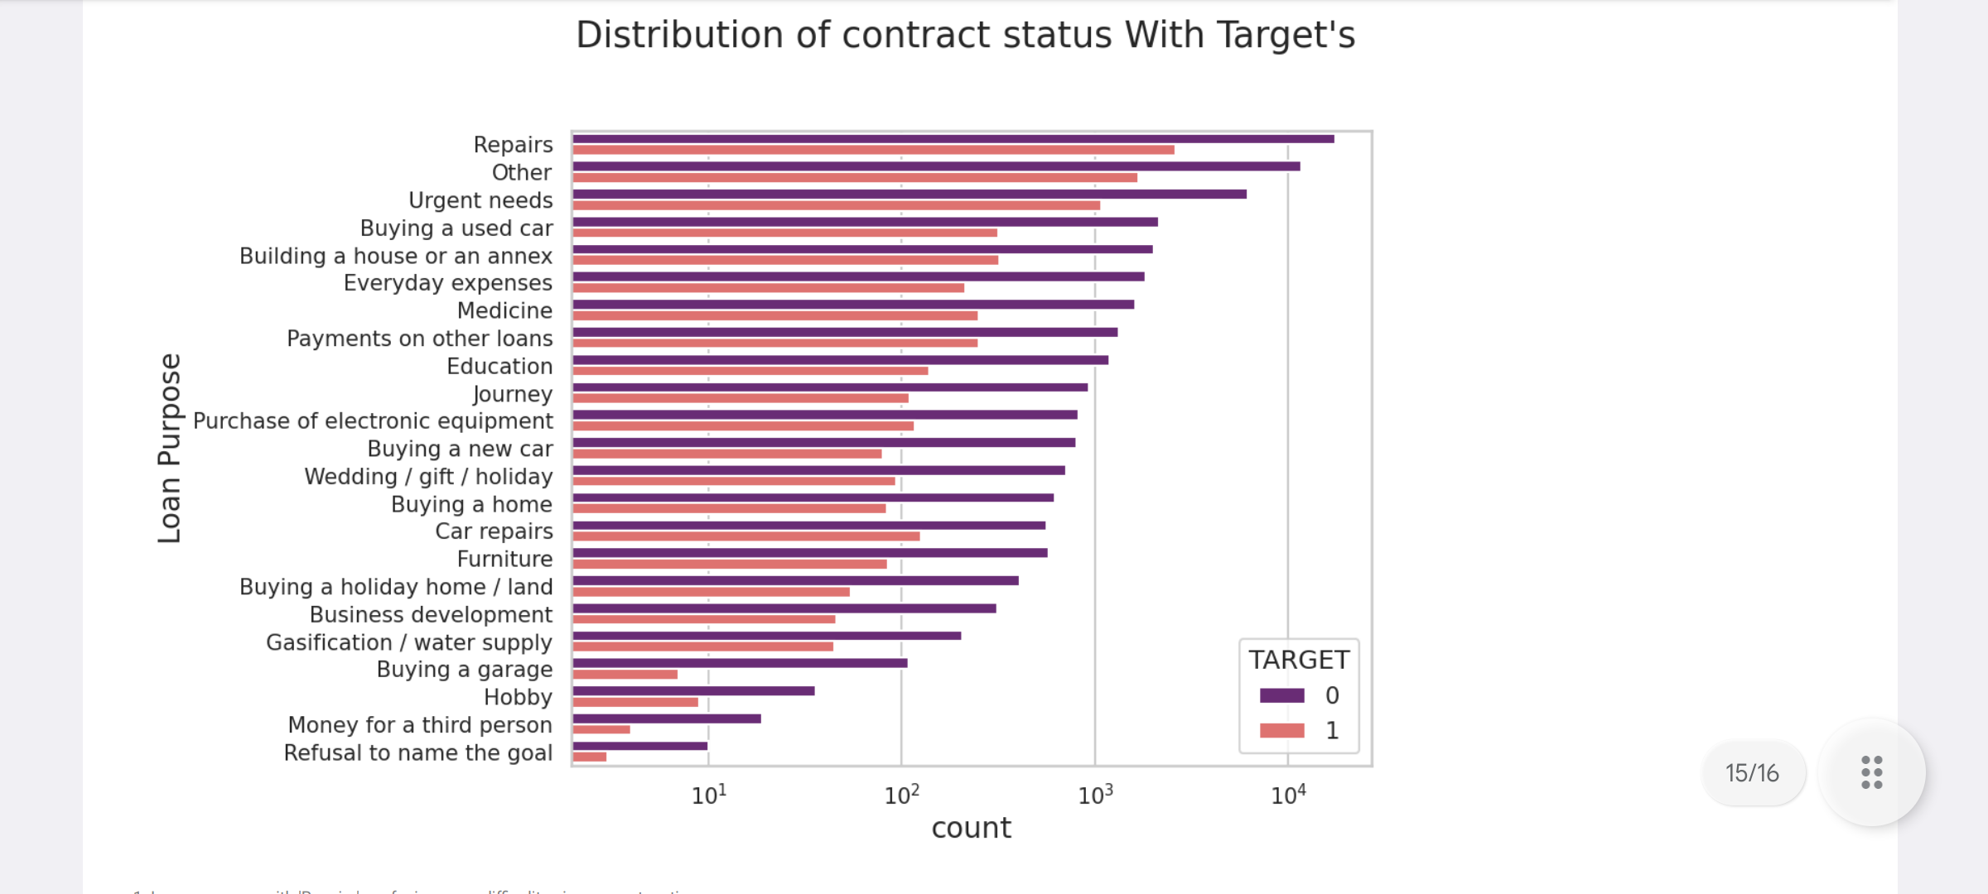
Loan purposes with 'Repairs' are facing more difficulty in payment on time.
There are few places where loan payment is significant higher than facing difficulties. They are 'Buying a garage', 'Business development'. 'Buying land','Buying a new car' and 'Education'. Hence we can focus on these purposes for which the client is having for minimal payment dificuties.

Slide 10
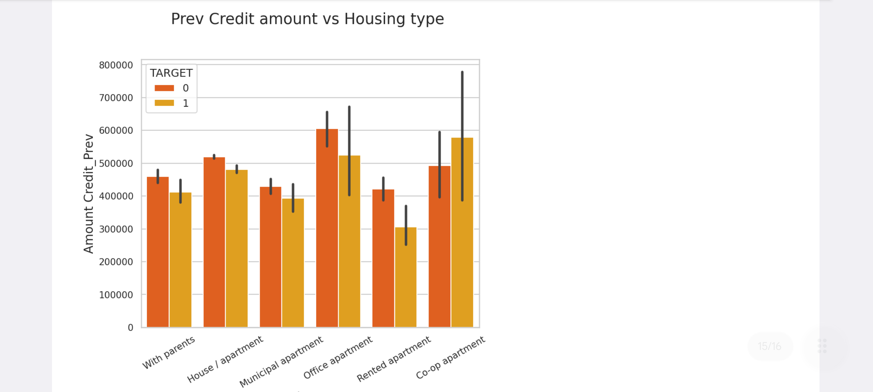
Here for Housing type, office apartment is having higher credit of target_0 and co-op apartment is having higher credit of target_1. So, we can conclude that bank should avoid giving loans to the housing type of co-op apartment as they are having difficulties in payment. Bank can focus mostly on housing type with parents or House-apartment or municipal apartment for successful payments.

Slide 11
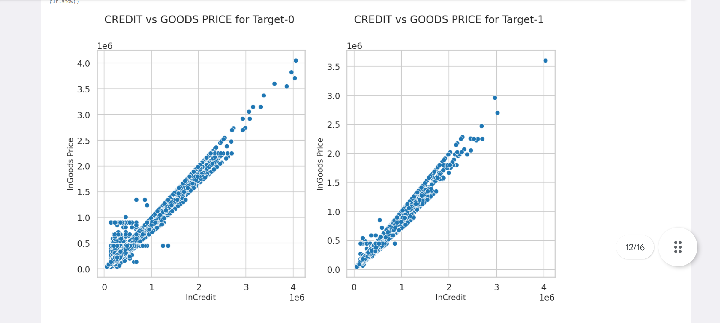
As per the analysis we can say that Goods Price and Credit are linearly distributed to each other or highly correlated to each other. So, if we increase goods, credit will also increase.

Slide 12
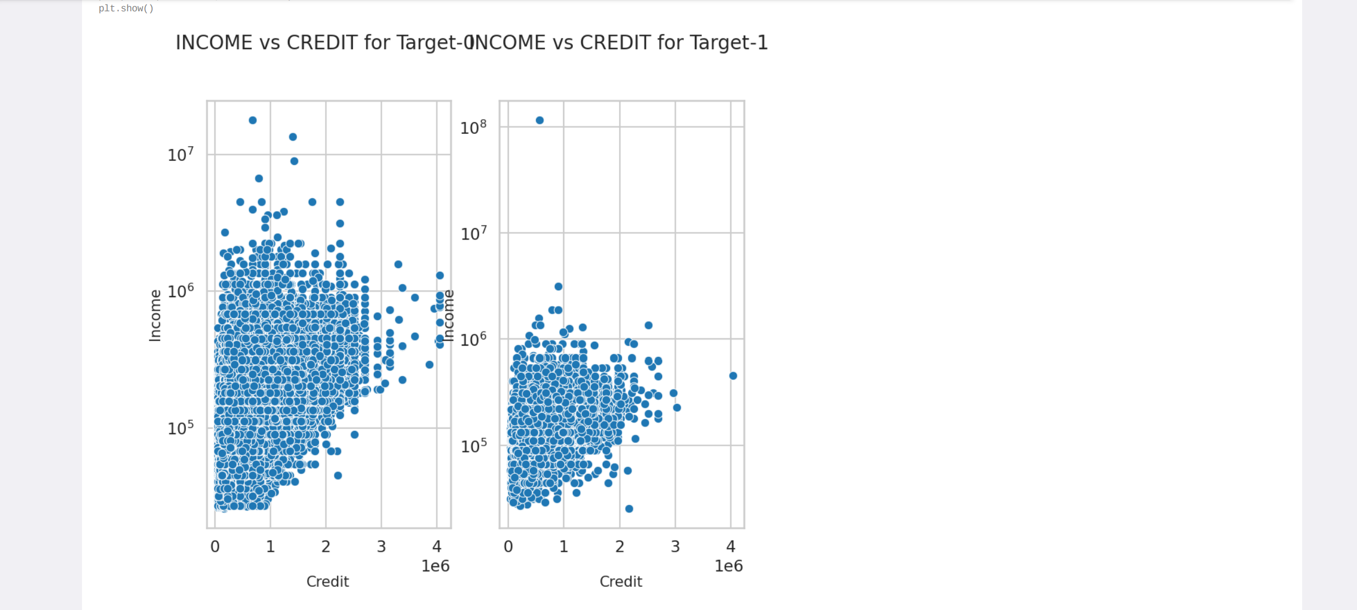
From the above graph we can say that defaulter income is less than non-defaulters.

Slide 13
Conclusion
Accept
1.Banks should approve loans more for Office apartment, Co-Op apartment housing type as there are less payment difficulties.
2.Banks should provide loans to Repairs & Others' purposes.
3.Banks should provide loans to the 'Business Entity Type-3' and 'Self-Employed' persons.
4.Working people especially female employers are the best to target for the loans.
5.old Female clients and Clients with higher education can be responsible person.

Slide 14
6.Bank should target refreshed clients who has unused loan status previously.
7.Any client who's previous loan was approved and Widow who has unused previous loan status.
8.Clients with high income category specially who are working as a state servant.

Slide 15
Reject
1.Lower secondary education clients are the most in number to be defaulted when their previous loans are cancelled or refused.
2.Male clients with civil marriage.
3.Previous refused loan status group, due to not paying in time.
4.Clients working as low-skilled labourers and having high child count(6-11).
5.Young clients with incomplete Higher Education. Students which are in college and school that can be default payment because of no income source.
6.Clients with less income and more family member should be take a look because there family expenses are more as compared to their income.

